Slide 1
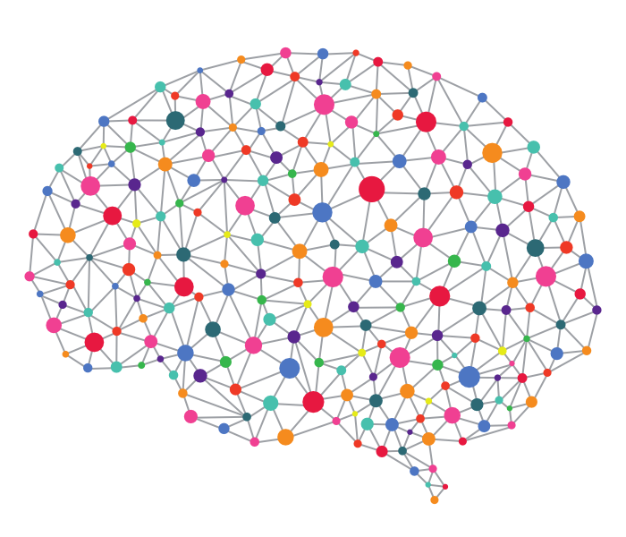
Position-aware Graph Neural Networks
2019.12.17

Slide 2
Outline
Preliminaries & Motivation
Proposed Approach
Theoretical Analysis
Experiments
Conclusion

Slide 3
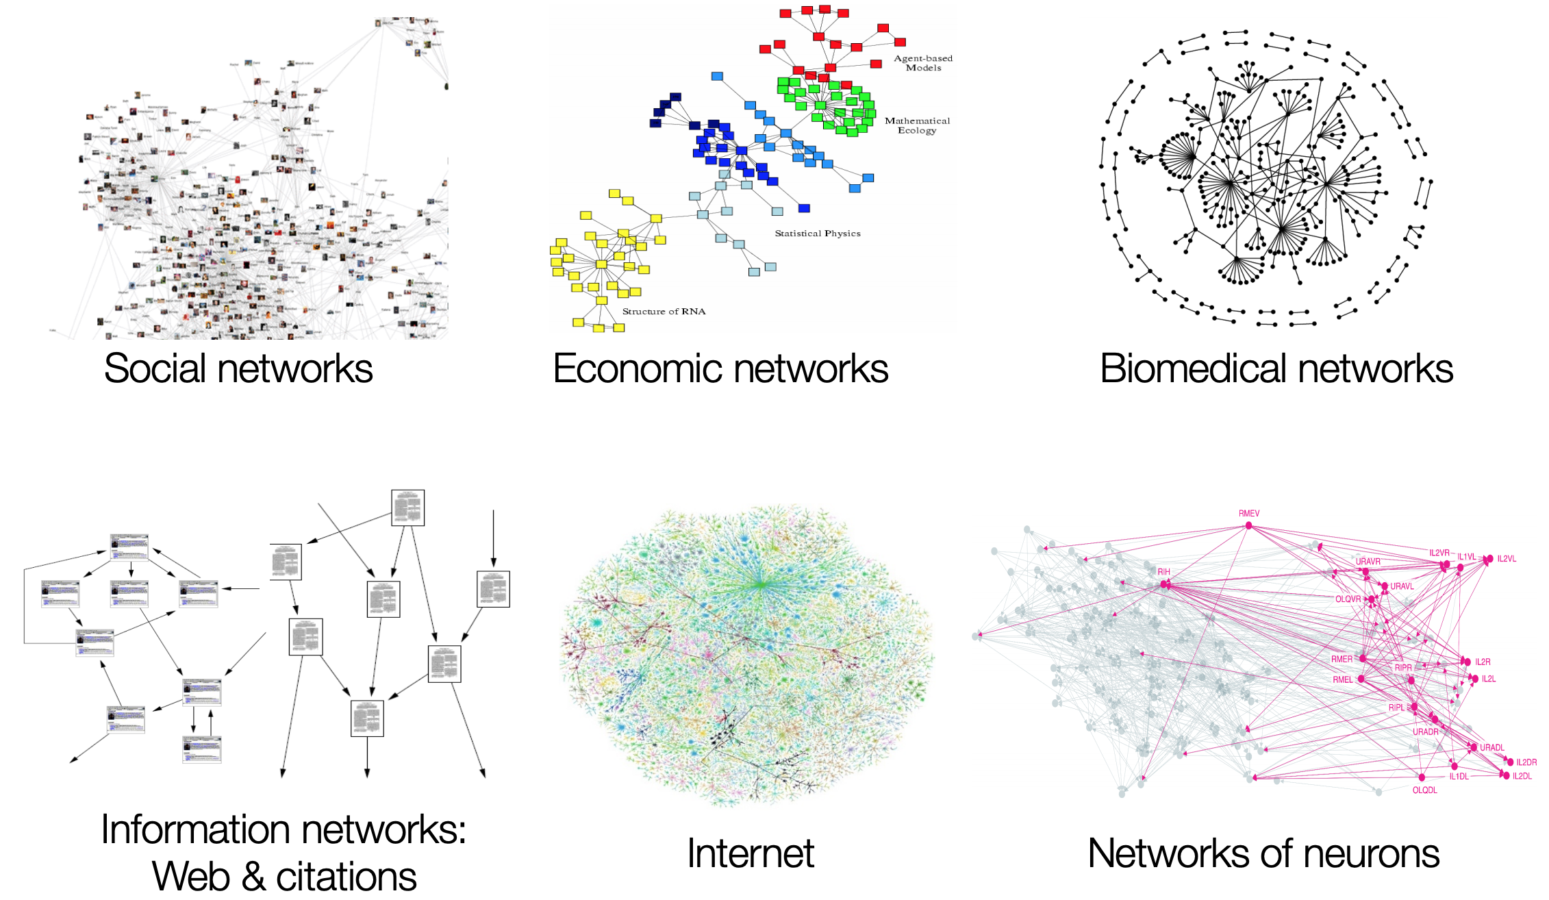
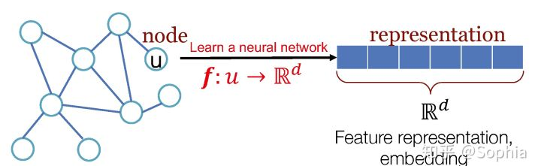
Background
Feature representation
embedding
Node classification
Link prediction
Graph classification
Graph generation
Notes:
给定一部分可观察的图，当新增节点时，我来预测这个节点是否会跟指定的结点有边的连接，比如在社交网络中，就是预测两个原来不相互关注的结点之后关注的可能性，就可以推荐好友，或者在生物医药方面，可以预测一种药物是否会产生某一种副作用，就去预测这种药物和副作用之间是否有边相连。

Slide 4
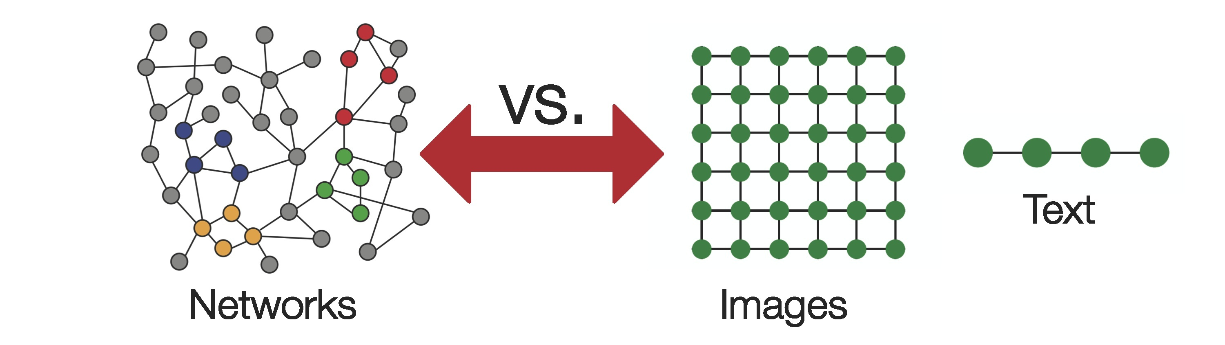
Difficult problems
Networks are complex!
Arbitrary size and complex topological structure
No fixed node ordering or reference point
Often dynamic and have multimodal feature

Slide 5
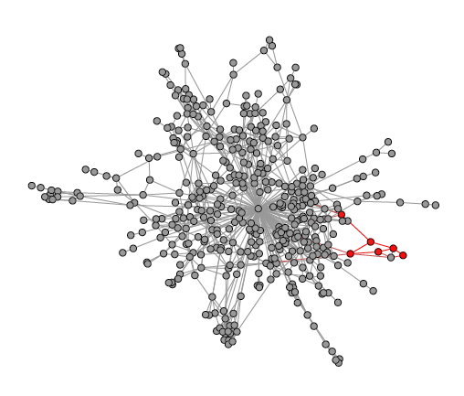
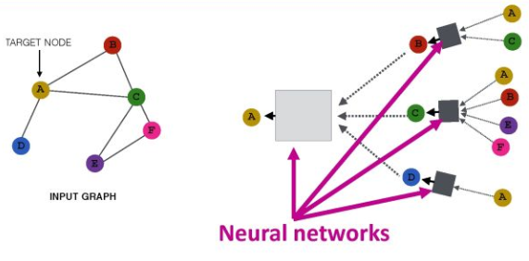
Limitation of existing GNNs
Random-walk approaches
limited to transductive settings
can not incorporate node attributes
GNN framework
fail to capture the position/location of the node within the broader context of the graph structure

Slide 6
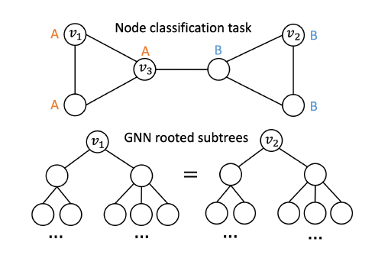
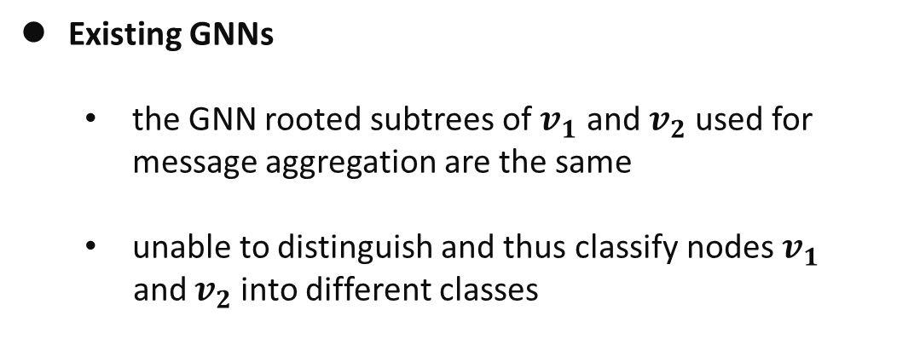
Limitation of existing GNNs
Existing GNNs
the GNN rooted subtrees of $v_{1}$ and $v_{2}$used for message aggregation are the same
unable to distinguish and thus classify nodes $v_{1}$
and $v_{2}$into different classes

Slide 7
Outline
Preliminaries & Motivation
Proposed Approach
Theoretical Analysis
Experiments
Conclusion

Slide 8
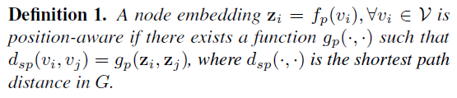
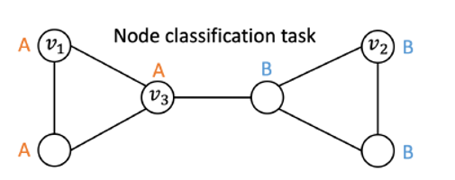
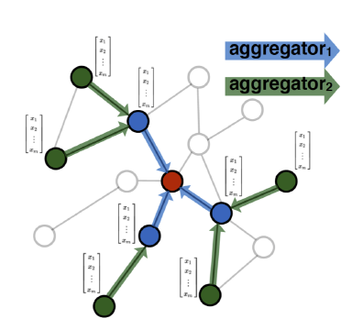
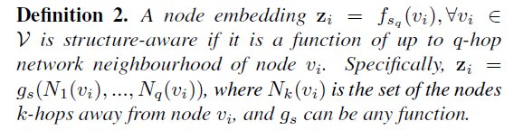
Position-aware GNN

Slide 9
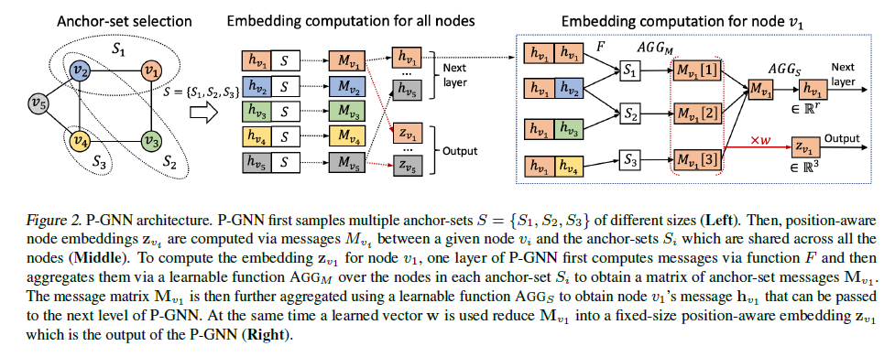
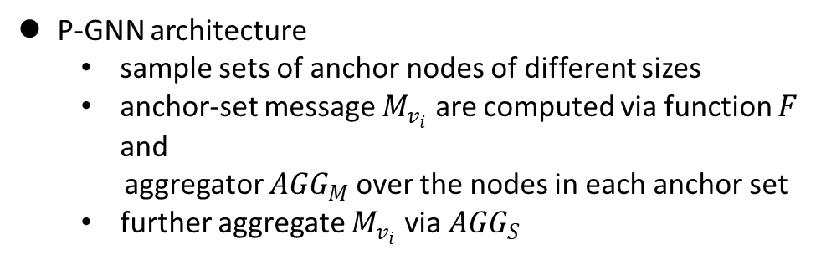
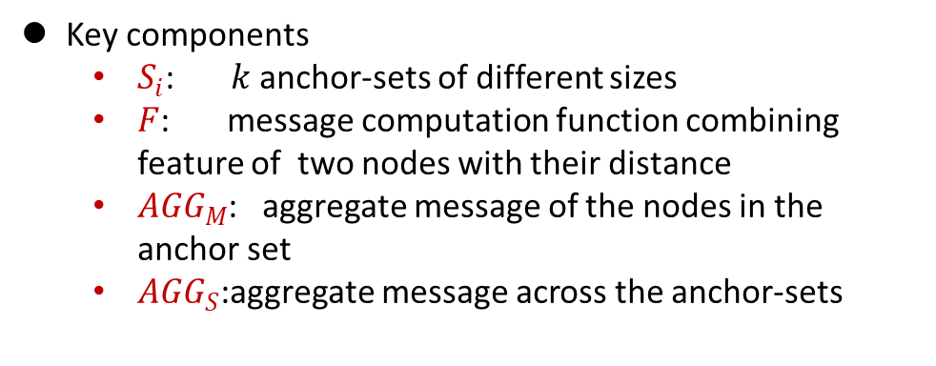
The Framework of P-GNNs
P-GNN architecture
sample sets of anchor nodes of different sizes
anchor-set message $M_{v_{i}}$ are computed via function $F$ and
aggregator ${AGG}_{M}$ over the nodes in each anchor set
further aggregate $M_{v_{i}}$ via ${AGG}_{S}$
Key components
$S_{i}$: $k$ anchor-sets of different sizes
$F$: message computation function combining feature of two nodes with their distance
${AGG}_{M}$: aggregate message of the nodes in the anchor set
${AGG}_{S}$:aggregate message across the anchor-sets

Slide 10
The Framework of P-GNNs
Mean, Min, Max
…
…

Slide 11
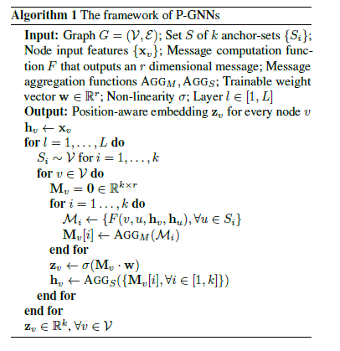
The Framework of P-GNNs

Slide 12
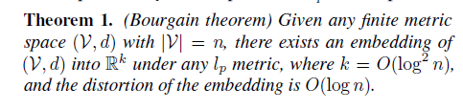
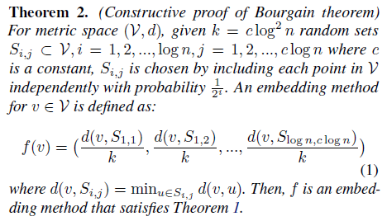
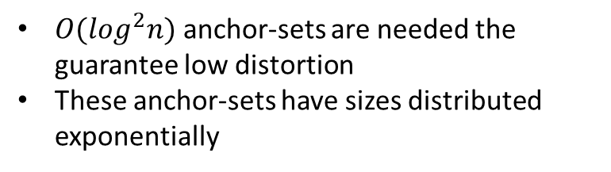
Anchor-set Selection
Shows the existing of a low distortion embedding
$O(log^{2}n)$ anchor-sets are needed the guarantee low distortion
These anchor-sets have sizes distributed exponentially

Slide 13
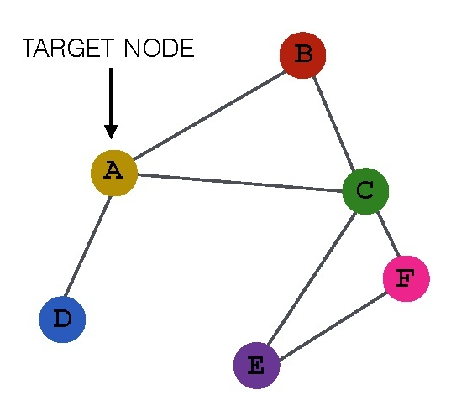
Anchor-set Selection
The intuition behind the sizes of anchor-sets
Small anchor-sets provide positional information with high certainly
Large anchor-sets can result in high sample efficiency
large set
small set

Slide 14
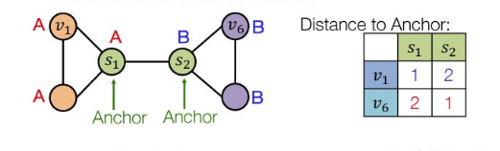


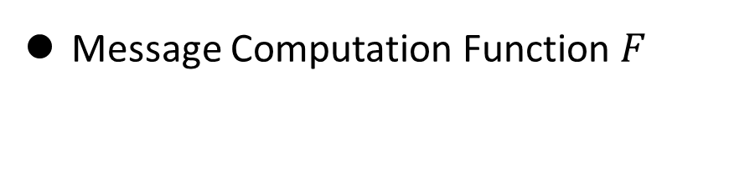
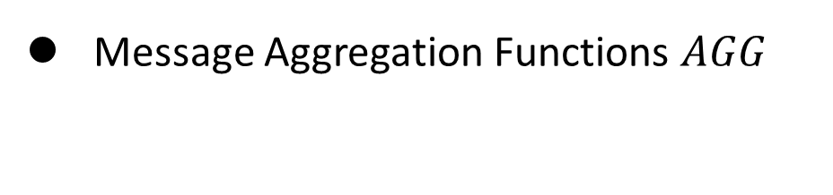
Design decision for P-GNNs
Message Computation Function $F$
Message Aggregation Functions $AGG$

Slide 15
Outline
Preliminaries & Motivation
Proposed Approach
Theoretical Analysis
Experiments
Conclusion

Slide 16
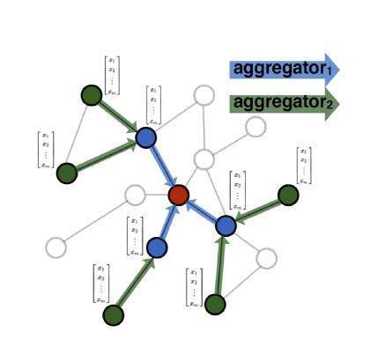
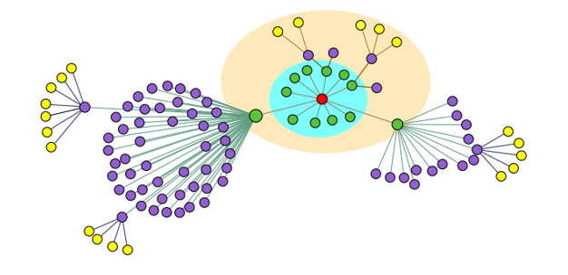
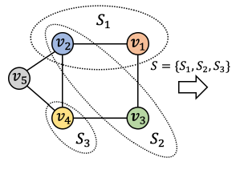
Connection to Existing GNNs
GraphSAGE
（stochastic neighbourhood）
GCN
（deterministic neighbourhood）
P-GNN
Notes:
现存的GNNs方法无非是确定结点和随机邻居节点的方法，两个典型代表是graphsage和GCN，从GraphSAGE的算法的聚合邻居节点的过程来看，它是从每一跳的结点之中随机采样了一定数量的结点。GRAPHSAGE可以视做P-GNN的特例，用P-GNN的观点来看，它随机采样了K个size==1的锚节点，并且利用与锚节点之间的最短路径将锚节点的特征融合到欲求结点中，从而获得structure特征。而P-GNN利用了更大的锚节点集，在graphsage中尺寸为1，而P-GNN中为更多的结点个数，这个结点个数的选择会在之后介绍，第二，这个锚节点集但是可以看到针对于每一个结点，锚节点的选择不同，这和P-GNN不相同，P-GNN中选择了所有结点共用的锚节点集，所以可以视为一种对于position即位置信息的参考，所以P-GNN可以捕捉到位置信息。而GCN是将每一个结点都视为锚节点，利用q跳的距离去聚合结点的信息，所以也可以视为P-GNN的特例。（但是复杂度和aggregate的方法影响了GCN的方法）

Slide 17
Expressive Power of P-GNNs
GNN function to evaluate embeddings:
GNN function to evaluate embeddings:
GNN representation learning objective:
P-GNN representation learning objective:

Slide 18
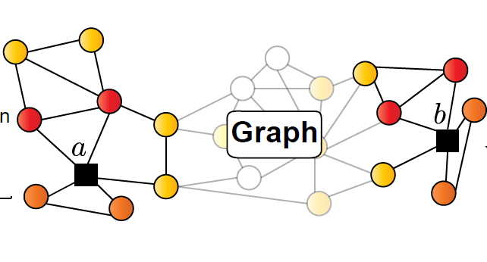
Expressive Power of P-GNNs
The marginal distribution of node embeddings:
The joint distribution of node embeddings:
The mutual information between node distribution and target tasks
On the tasks related to the positional information of nodes
The gap of two mutual information is great

Slide 19
Complexity Analysis
Aggregating message of nodes
O(ne) for existing GNNs
O(mnlog²n) for P-GNN
Conclusion
Irrelative with the average degree of nodes
Efficient than GNNs in dense graph
potential to be sped up to O(nlog²n)
Notes:
现存的GNNs方法无非是确定结点和随机邻居节点的方法，两个典型代表是graphsage和GCN，从GraphSAGE的算法的聚合邻居节点的过程来看，它是从每一跳的结点之中随机采样了一定数量的结点。GRAPHSAGE可以视做P-GNN的特例，用P-GNN的观点来看，它随机采样了K个size==1的锚节点，并且利用与锚节点之间的最短路径将锚节点的特征融合到欲求结点中，从而获得structure特征。而P-GNN利用了更大的锚节点集，在graphsage中尺寸为1，而P-GNN中为更多的结点个数，这个结点个数的选择会在之后介绍，第二，这个锚节点集但是可以看到针对于每一个结点，锚节点的选择不同，这和P-GNN不相同，P-GNN中选择了所有结点共用的锚节点集，所以可以视为一种对于position即位置信息的参考，所以P-GNN可以捕捉到位置信息。而GCN是将每一个结点都视为锚节点，利用q跳的距离去聚合结点的信息，所以也可以视为P-GNN的特例。（但是复杂度和aggregate的方法影响了GCN的方法）

Slide 20
Outline
Preliminaries & Motivation
Proposed Approach
Theoretical Analysis
Experiments
Conclusion

Slide 21
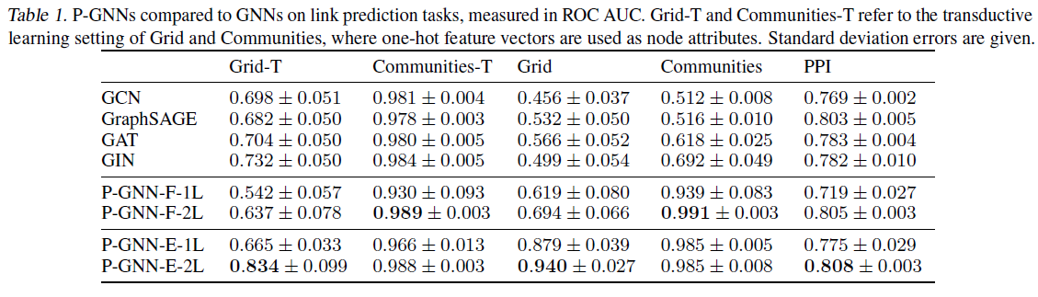
Results on link prediction tasks
Dataset: Grid, Communities, PPI

Slide 22
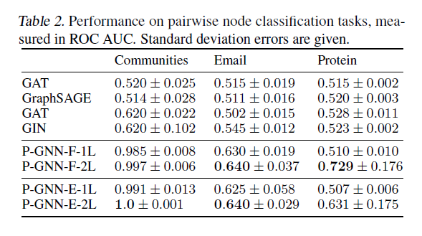
Results on pairwise node classification tasks
Dataset: Communities, Email, Protein

Slide 23
Outline
Preliminaries & Motivation
Proposed Approach
Theoretical Analysis
Experiments
Conclusion

Slide 24
Conclusions
Incorporate node positional information
Maintain the advantages of existing GNNs
Retain inductive capability
Utilizing node features

